Slide 1
Navtor AS Sondre Knudsen, Business Analyst

Slide 2
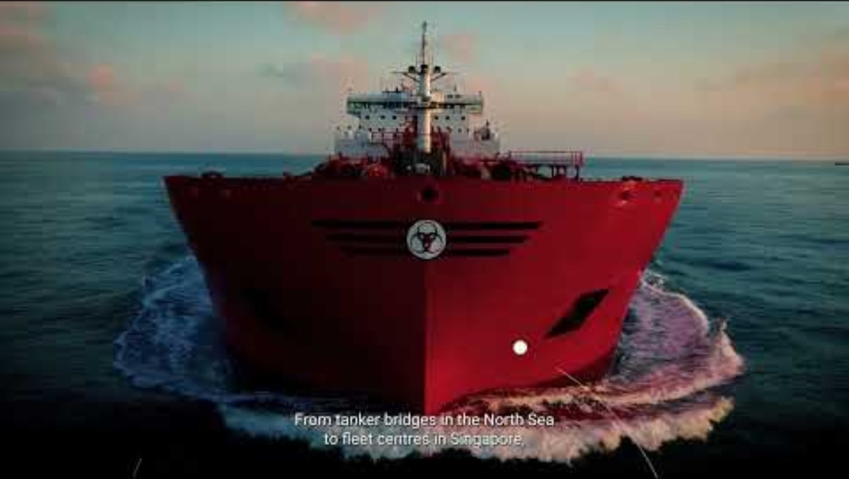

Slide 3
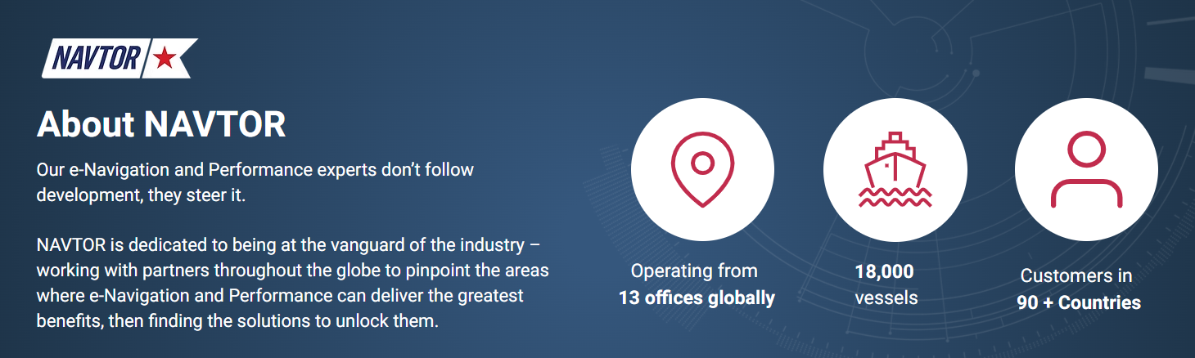

Slide 4
System integration overview
NAV Tracker
Backoffice
Order fulfilment API
Order type (Local invoicing or not)
Customer Price, discount, and currency
IC Price (always USD)
Shipping grouping key
Delivery Address
Planned Shipping Date.
BO is item master. New items are generated in BO and pushed to BC
A select number of fields will be allowed to be updated from BC or exist only in BC to make procurement and order processing more efficient.
Selected fields will be pushed to BO when changed in BC.
Freshdesk
API 4
Master data
Invoicing
Shipping
API 2
API 3
API 5a
API 5b
API 1
API 7
API 6
Master data API
Availability API
Invoice / Credit Memo API Invoice to customer
Order Return
Create Salesorder
for shipment
Cancel Sales order
NAVTOR (Master)
NAVTOR – NO
Drones (SE,GR,JP,SG,US)
Cancel only until shipped
Norwegian environment
Availability data for all drones
Returnorder
Edition
Purchase invoice
Warehouse data. What country is up and serves what destination
Receipt
Items. BO Mastered *
Order
MS ICT
Customers BO=Master
Dimensions *
Order
Sales Order
Sales Order
Combined Shipments
Vendors
Invoice approval process
Invoice Always USD
TMS
BC tenant
Shipment
Invoice
Invoice Any currency
Credit Memo
DHL++
Labels
Picking list
Transport documents
Tracking No
Customer

Slide 5
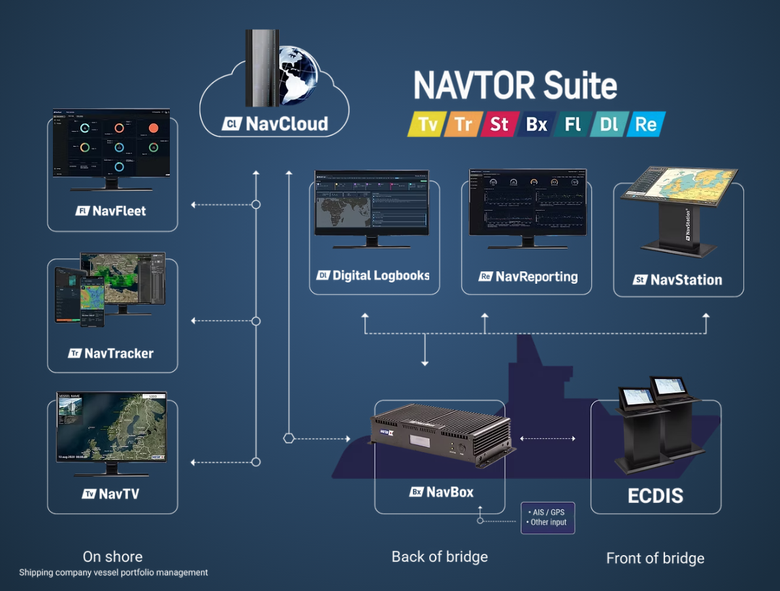

Slide 6
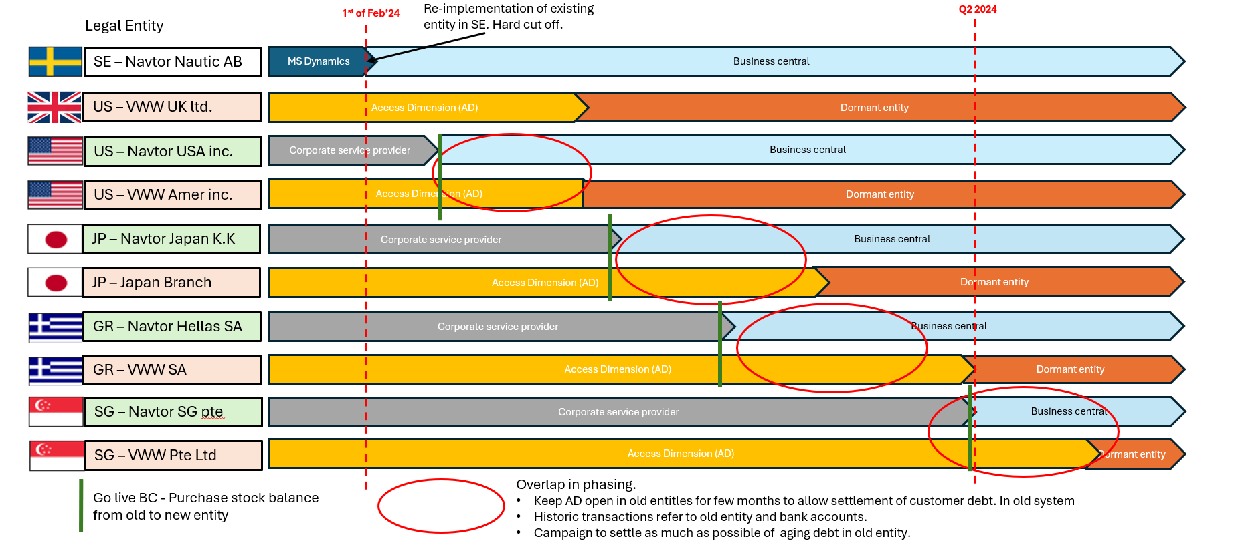
Global utrulling

Slide 7
